Slide 1
VPN
Virtual private network

Slide 2
How does a VPN work?
VPN stands for "Virtual Private Network" and describes the opportunity to establish a protected network connection when using public networks. VPNs encrypt your internet traffic and disguise your online identity. This makes it more difficult for third parties to track your activities online and steal data. The encryption takes place in real time.
A VPN hides your IP address by letting the network redirect it through a specially configured remote server run by a VPN host. This means that if you surf online with a VPN, the VPN server becomes the source of your data. This means your Internet Service Provider (ISP) and other third parties cannot see which websites you visit or what data you send and receive online. A VPN works like a filter that turns all your data into "gibberish". Even if someone were to get their hands on your data, it would be useless.

Slide 3
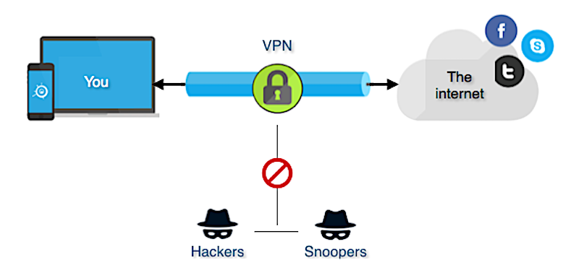

Slide 4
What are the benefits of a VPN connection?
Secure encryption: To read the data, you need an encryption key . Without one, it would take millions of years for a computer to decipher the code in the event of a brute force attack . With the help of a VPN, your online activities are hidden even on public networks.
Disguising your whereabouts : VPN servers essentially act as your proxies on the internet. Because the demographic location data comes from a server in another country, your actual location cannot be determined. In addition, most VPN services do not store logs of your activities. Some providers, on the other hand, record your behavior, but do not pass this information on to third parties. This means that any potential record of your user behavior remains permanently hidden.
Access to regional content: Regional web content is not always accessible from everywhere. Services and websites often contain content that can only be accessed from certain parts of the world. Standard connections use local servers in the country to determine your location. This means that you cannot access content at home while traveling, and you cannot access international content from home. With VPN location spoofing , you can switch to a server to another country and effectively “change” your location.
Secure data transfer: If you work remotely, you may need to access important files on your company’s network. For security reasons, this kind of information requires a secure connection. To gain access to the network, a VPN connection is often required. VPN services connect to private servers and use encryption methods to reduce the risk of data leakage.

Slide 5
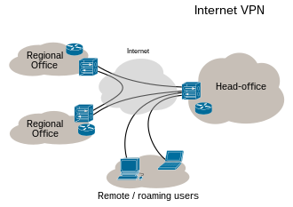

Slide 6
VPNs and their current use
According to the GlobalWebIndex, the number of VPN users worldwide increased more than fourfold between 2016 and 2018. In countries such as Thailand, Indonesia and China, where internet use is restricted and censored, one in fiveinternet users uses a VPN. In the USA, Great Britain and Germany, the proportion of VPN users is lowerat around 5%, but is growing.
One of the biggest drivers for VPN adoption in recent years has been the increasing demand for content with geographical access restrictions. For example, video streaming services such as Netflix or YouTube make certain videos available only in certain countries. With contemporary VPNs, you can encrypt your IP address so that you appear to be surfing from another country, enabling you to access this content from anywhere.

Slide 7
What kind of VPNs are there?
SSL VPN
Often not all employees of a company have access to a company laptop they can use to work from home. During the corona crisis in Spring 2020, many companies faced the problem of not having enough equipment for their employees. In such cases, use of a private device (PC, laptop, tablet, mobile phone) is often resorted to. In this case, companies fall back on an SSL-VPN solution, which is usually implemented via a corresponding hardware box.
Site-to-site VPN
A site-to-site VPN is essentially a private network designed to hide private intranets and allow users of these secure networks to access each other's resources.
A site-to-site VPN is useful if you have multiple locations in your company, each with its own local area network (LAN) connected to the WAN (Wide Area Network). Site-to-site VPNs are also useful if you have two separate intranets between which you want to send files without users from one intranet explicitly accessing the other.

Slide 8
Client-to-Server VPN
Connecting via a VPN client can be imagined as if you were connecting your home PC to the company with an extension cable. Employees can dial into the company network from their home office via the secure connection and act as if they were sitting in the office. However, a VPN client must first be installed and configured on the computer.
This involves the user not being connected to the internet via his own ISP, but establishing a direct connection through his/her VPN provider.
Is a VPN really so secure?
It is important to note that VPNs do not function like comprehensive anti-virus software. While they protect your IP and encrypt your internet history, a VPN connection does not protect your computer from outside intrusion. To do this, you should definitely use anti-virus software such as Kaspersky Internet Security . Because using a VPN on its own does not protect you from Trojans, viruses, bots or other malware.

Slide 9
References
https://www.kaspersky.com/resource-center/definitions/what-is-a-vpn
https://en.wikipedia.org/wiki/Virtual_private_network

